Slide 1
Lending Club Case Study
-by Tanushree Dharpure

Slide 2
Problem Statement
You work for a consumer finance company which specializes in lending various types of loans to urban customers.
When the company receives a loan application, the company must decide for loan approval based on the
applicant’s profile. Two types of risks are associated with the bank’s decision:
If the applicant is likely to repay the loan, then not approving the loan results in a loss of business to the company
If the applicant is not likely to repay the loan, i.e., he/she is likely to default, then approving the loan may lead to a financial loss for the company
The data given below contains the information about past loan applicants and whether they ‘defaulted’ or not.
The aim is to identify patterns which indicate if a person is likely to default, which may be used for taking
actions such as denying the loan, reducing the amount of loan, lending (to risky applicants) at a higher interest rate, etc.

Slide 3
Data sourcing
Data sourcing is the process of extracting data from multiple internal and external sources and transforming it into analysis that fulfils business purposes like creating a firm's data infrastructure for daily workflows and other business objectives.
For this case study we have "loan dataset”.

Slide 4
What is data cleaning?
Data cleaning is the process of fixing or removing incorrect, corrupted, incorrectly formatted, duplicate, or incomplete data within a dataset.
When combining multiple data sources, there are many opportunities for data to be duplicated or mislabelled.
If data is incorrect, outcomes and algorithms are unreliable, even though they may look correct.
There is no one absolute way to prescribe the exact steps in the data cleaning process because the processes will vary from dataset to dataset.
But it is crucial to establish a template for your data cleaning process, so you know you are doing it the right way every time.

Slide 5
Why Univariate Statistics?
Univariate analysis explores each variable in a data set, separately. It looks at the range of values, as well as the central tendency of the values.
It describes the pattern of response to the variable.
It describes each variable on its own.
Descriptive statistics describe and summarize data.
Univariate descriptive statistics describe individual variables.

Slide 6
Segmented Univariate analysis
Segmented Univariate analysis can be used to find summary of a single data variable in form of segments.
The dataset variable is divided into subsets and patterns can be observed across the segments.
The central tendencies such as mean, mode, and median; maximum and minimum; range; variance and standard deviation are also detected.
Visualized charts of various kind are used to show the description.

Slide 7
What is bivariate analysis?
Bivariate analysis is a statistical method examining how two different things are related.
The bivariate analysis aims to determine if there is a statistical link between the two variables and, if so, how strong and in which direction that link is.
It is a helpful technique for determining how two variables are connected and finding trends and patterns in the data.
Recognizing bivariate data is a prerequisite for analysis. Typically, X and Y are two of the measures included. The bivariate data can be understood as a pair (X, Y ).

Slide 8
why bivariate analysis is important:
Bivariate analysis helps identify trends and patterns: It can reveal hidden data trends and patterns by evaluating the relationship between two variables.
Bivariate analysis helps identify cause and effect relationships: It can assess if two variables are statistically associated, assisting researchers in establishing which variable causes the other.
It helps researchers make predictions: It allows researchers predict future results by modeling the link between two variables.
It helps inform decision-making: Business, public policy, and healthcare decision-making can benefit from bivariate analysis.

Slide 9
Derived metrics
A derived metric is a calculation based on the data included in the report definition.
You can use derived metrics to perform column math, for example, calculations on metrics included in the report definition, without regenerating or re-executing SQL against the data warehouse.
Derived metrics are easy to create and can be made on the fly when you are viewing a report. A typical case is to create a derived metric to perform calculations between columns of metric data.

Slide 10
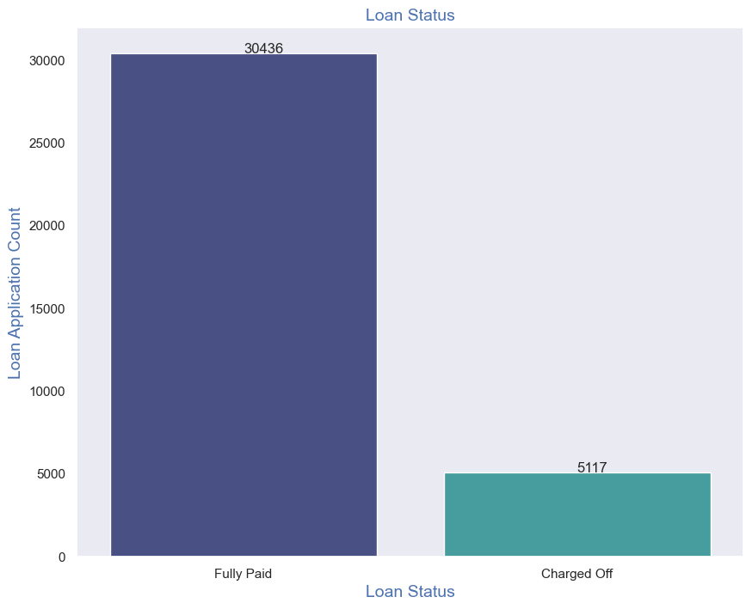
Univariate Analysis Unordered Categorical Variables - Loan Status
Observations :
Plot shows that close to 14% loans were charged off out of total loan issued.

Slide 11
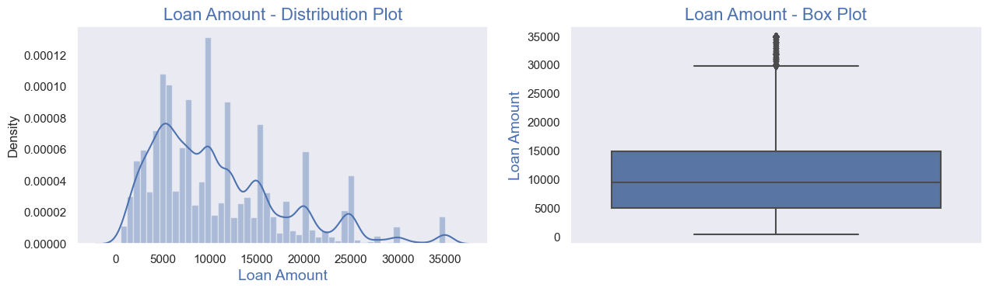
Univariate Analysis on Loan amount-Quantitative Variables
Observation:
Distribution of amounts for all three looks very much similar.
We will work with only loan amount column for rest of our analysis.

Slide 12
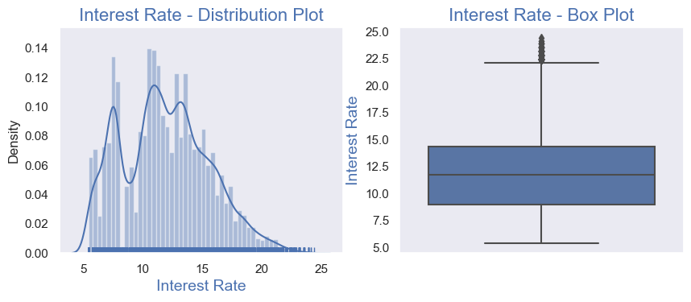
Univariate Analysis on Annual Income - Quantitative Variables
Observations :
Plots show that most of the borrower's Annual incomes are in range of 40000- 80000

Slide 13
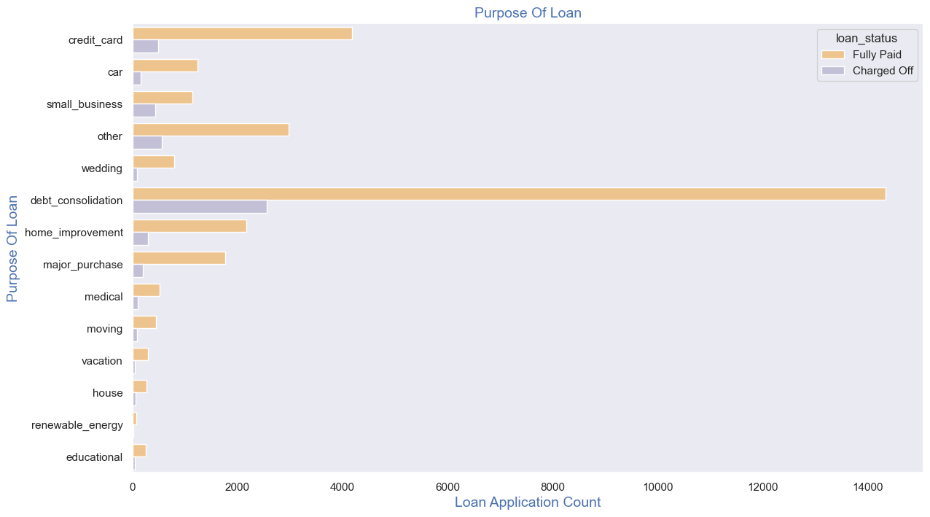
Univariate Analysis – Unordered Categorical Variables - Purpose Of Loan
Observations :
Below plot shows that most of the loans were taken for the purpose of debt consolidation & paying credit card bill.
Number of chraged off count also high too for these loans.

Slide 14
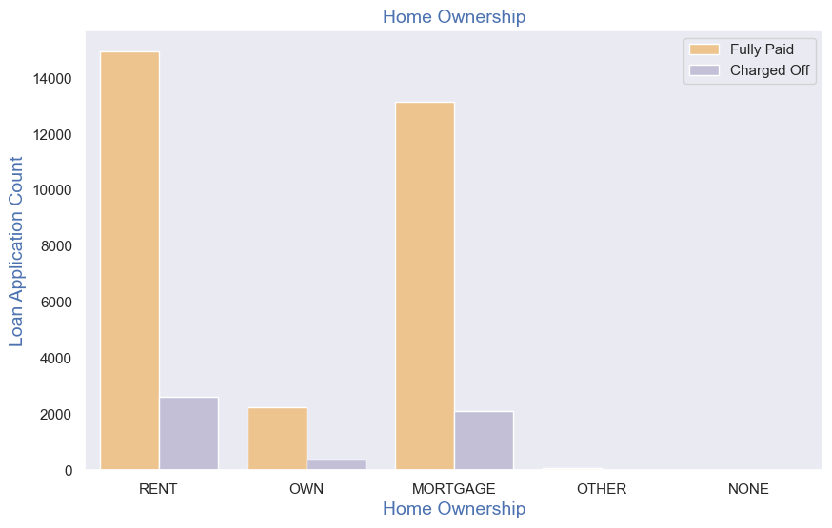
Univariate Analysis - Unordered Categorical Variables - Home Ownership
Observations :
Below plot shows that most of them living in rented home or mortgazed their home.
Applicant numbers are high from these categories so charged off is high too.

Slide 15
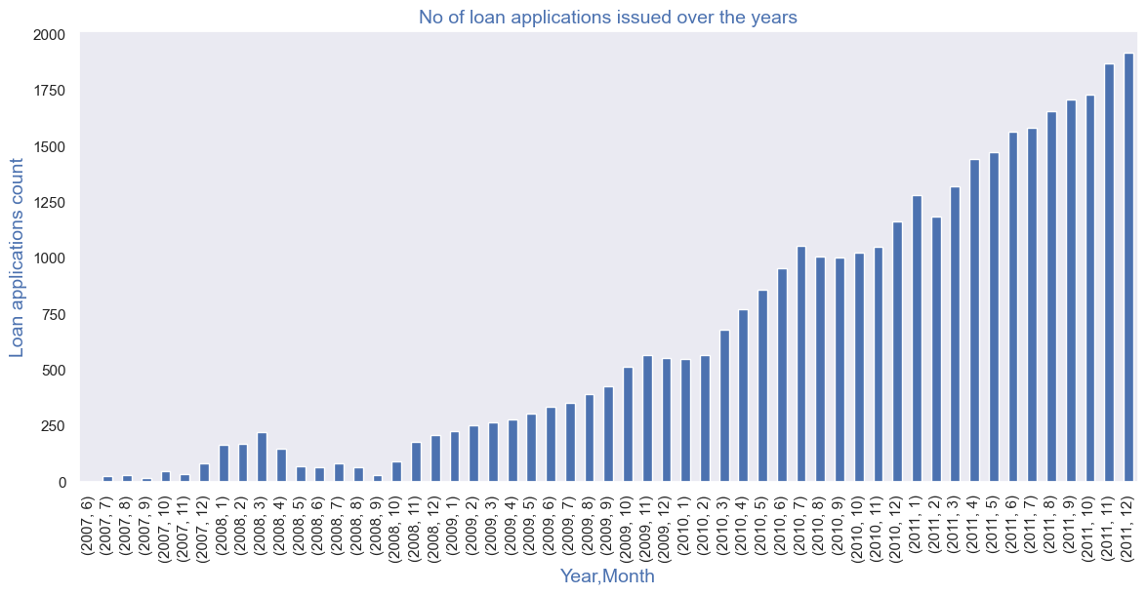
Derived Column - Ordered Categorical Variables
Observation is that count of loan application is increasing every passing year.
so increase in number of loan applications are adding more to number of charged off applications.
number of loans issued in 2008( May-October) got dipped, may be due to Recession.

Slide 16
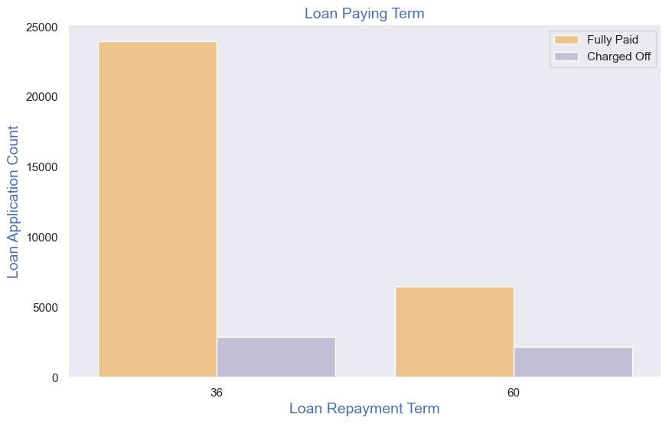
Univariate Analysis - Ordered Categorical Variables- Loan Paying Term
Observations :
Below plot shows that those who had taken loan to repay in 60 months had more % of number of applicants getting
charged off as compared to applicants who had taken loan for 36 months.

Slide 17
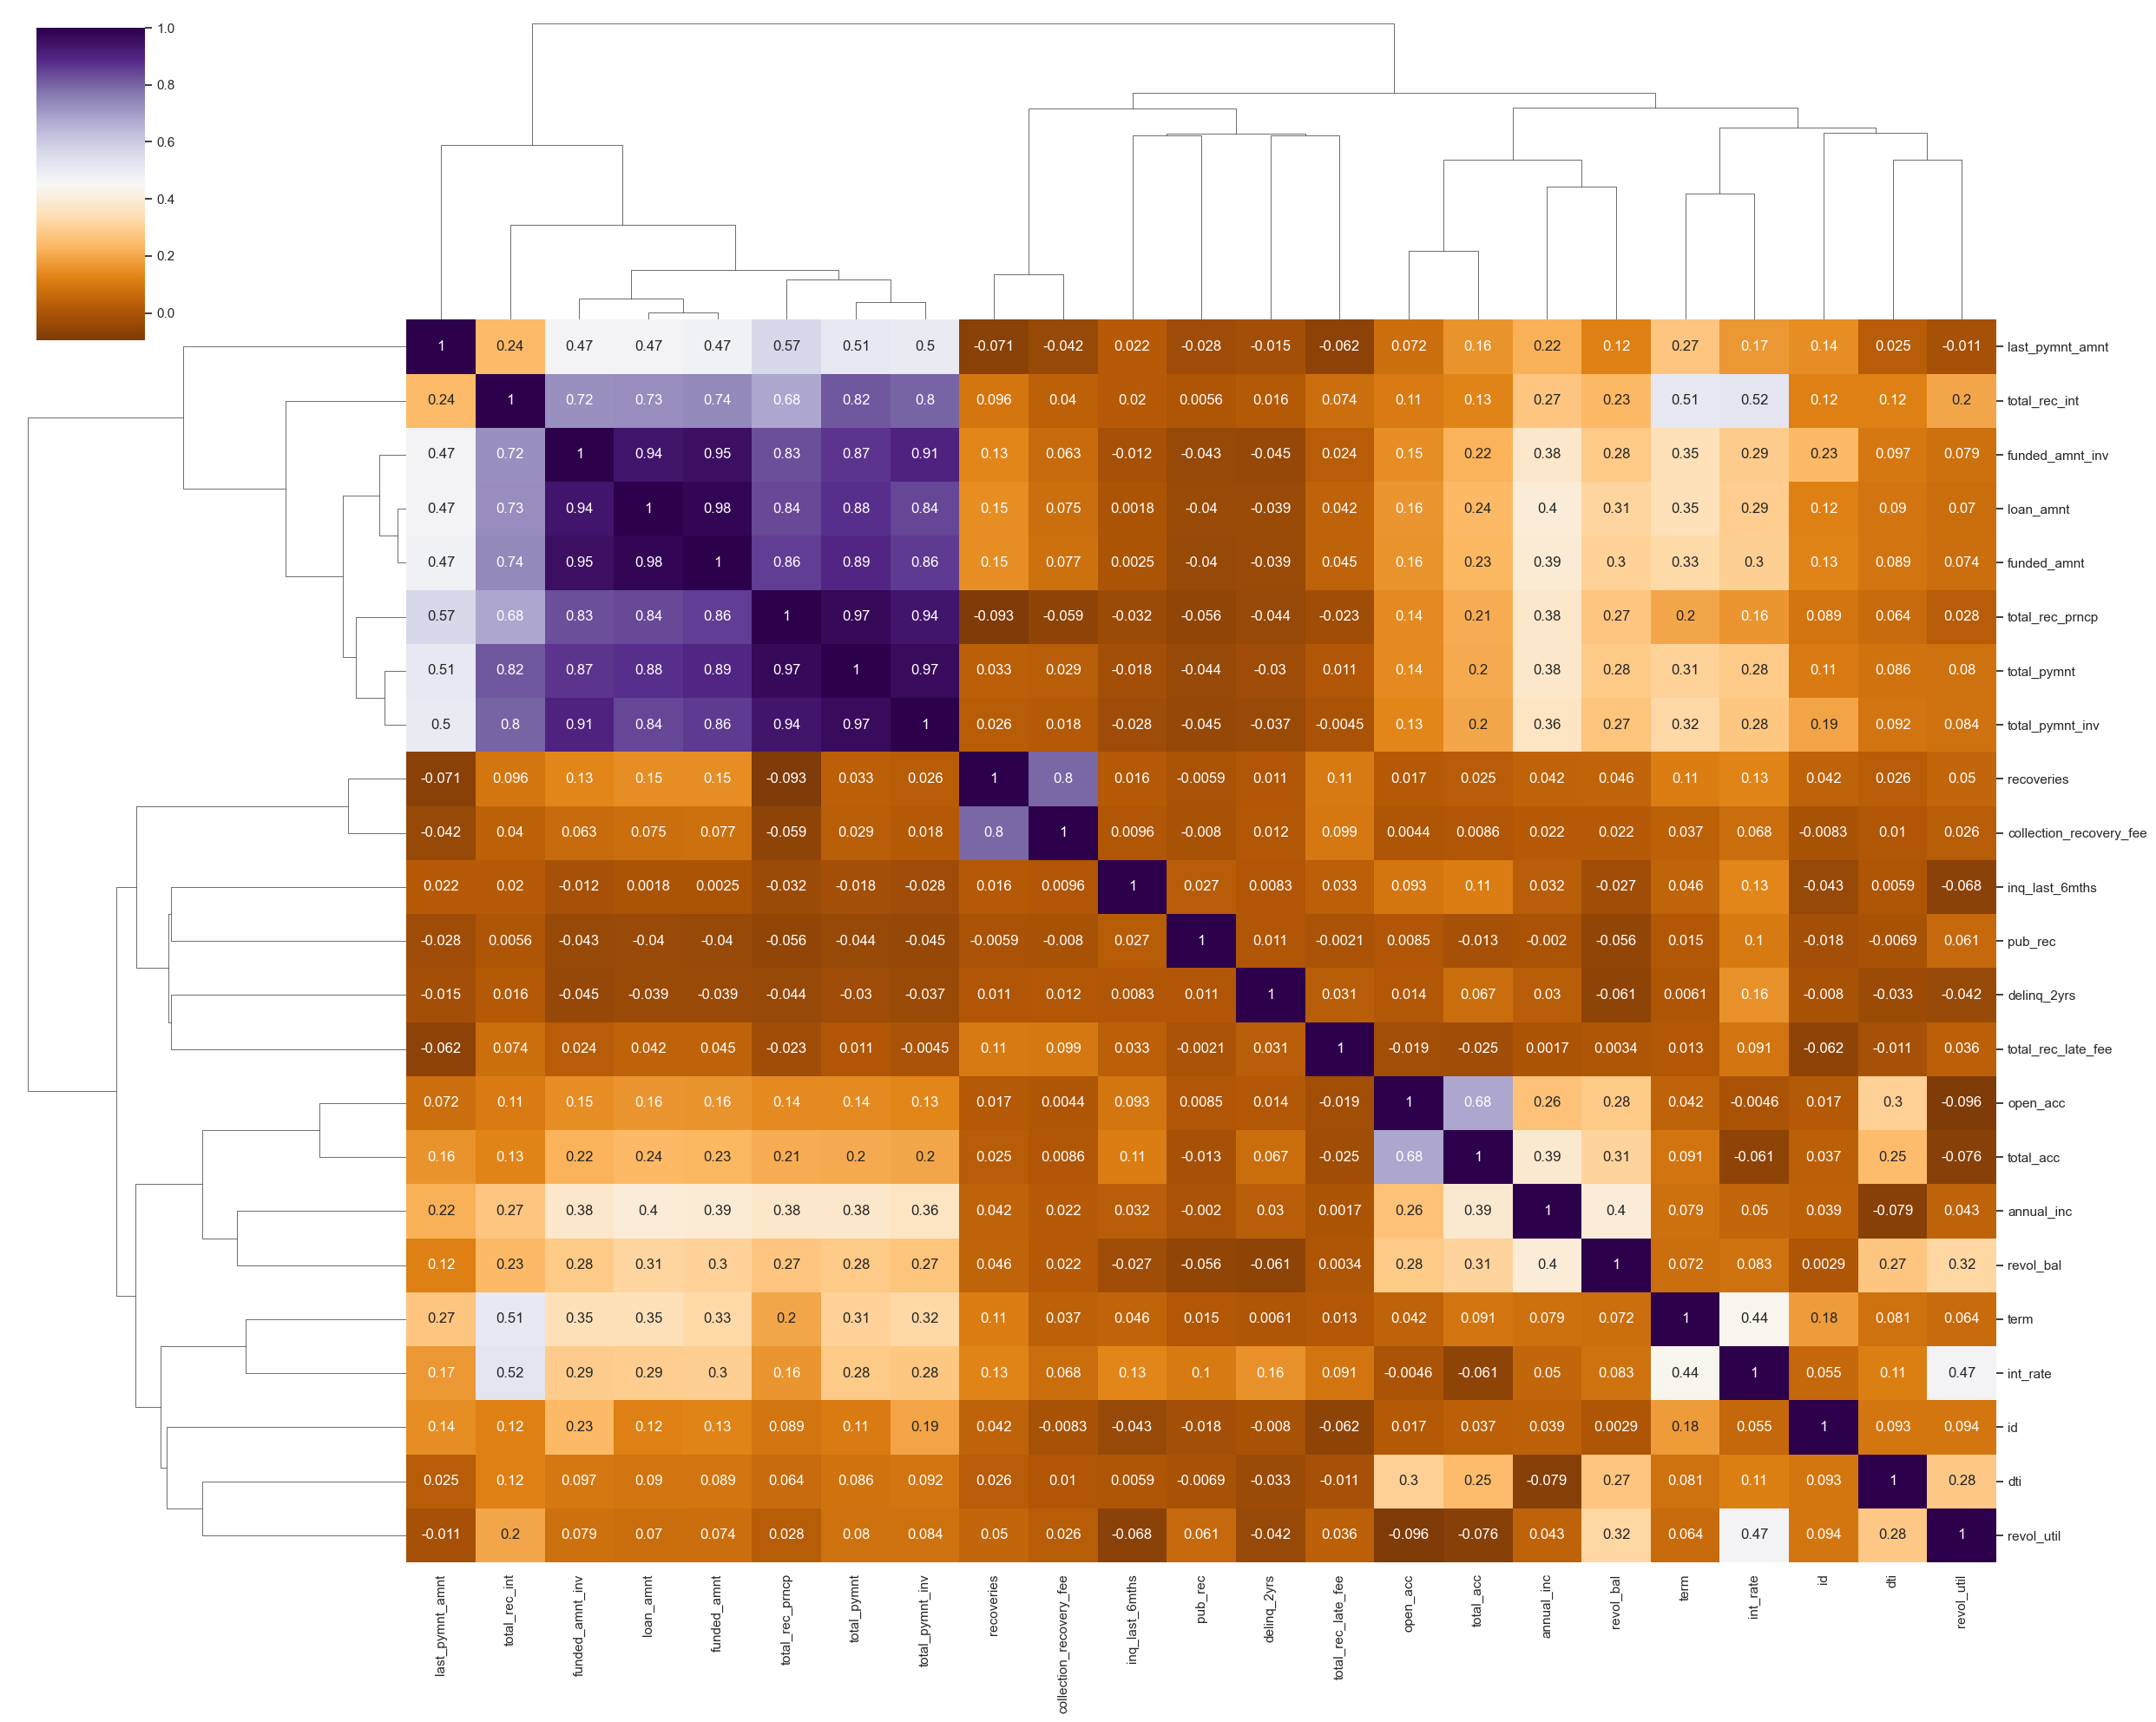
Bivariate Analysis - Correlation Matrix-Quantitative Variables

Slide 18
Bivariate Analysis - Correlation Matrix-Quantitative Variables
Observation :
Loan amount, investor amount, funding amount are strongly correlated.
Annual income with DTI(Debt-to-income ratio) is negatively correalted.
Debt income ratio is the percentage of a consumer's monthly gross income that goes toward paying debts.
That means when annual income is low DTI is high & vice versa.
positive correlation between annual income and employment years.
That means income increases with work experience.

Slide 19
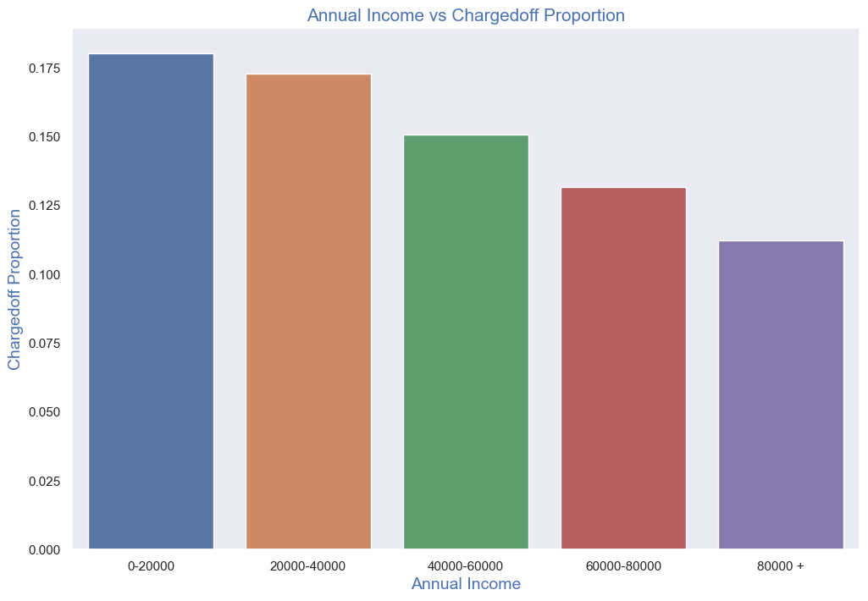
Bivariate Analysis on annual income against Chargedoff_Proportion
Observations:
Income range 80000+ has less chances of charged off.
Income range 0-20000 has high chances of charged off.
Notice that with increase in annual income charged off proportion got decreased.

Slide 20
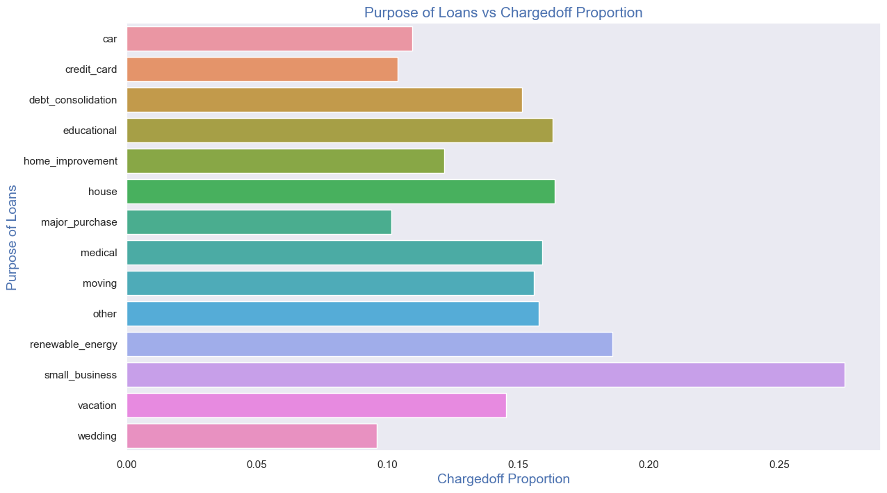
Bivariate Analysis on purpose of Loan against Chargedoff_Proportion
Observations:
Small Business applicants have high chances of getting charged off.
Renewable energy where Chargedoff proportion is better as compare to other categories.

Slide 21
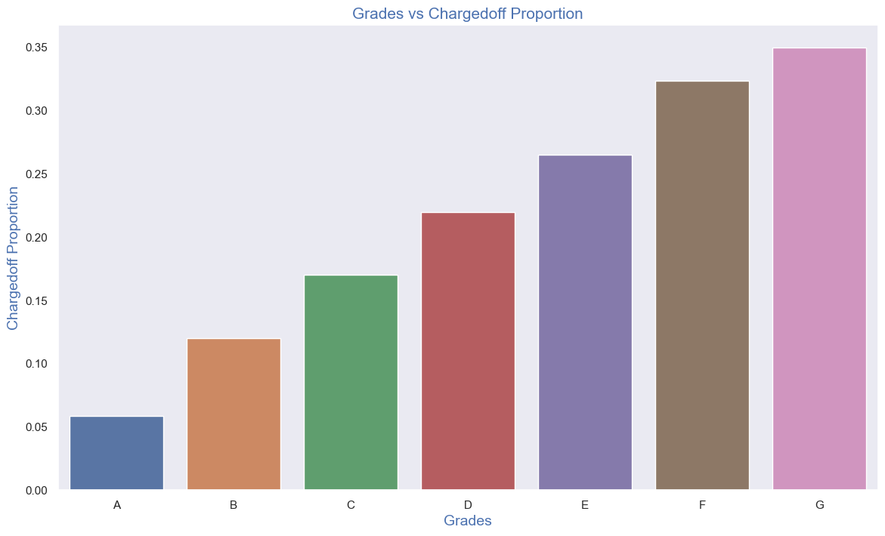
Bivariate Analysis on grade against Chargedoff_Proportion
Observations:
Grade "A" has very less chances of charged off.
Grade "F" and "G" have very high chances of charged off.
Chances of charged off is increasing with grade moving from "A" towards "G"

Slide 22
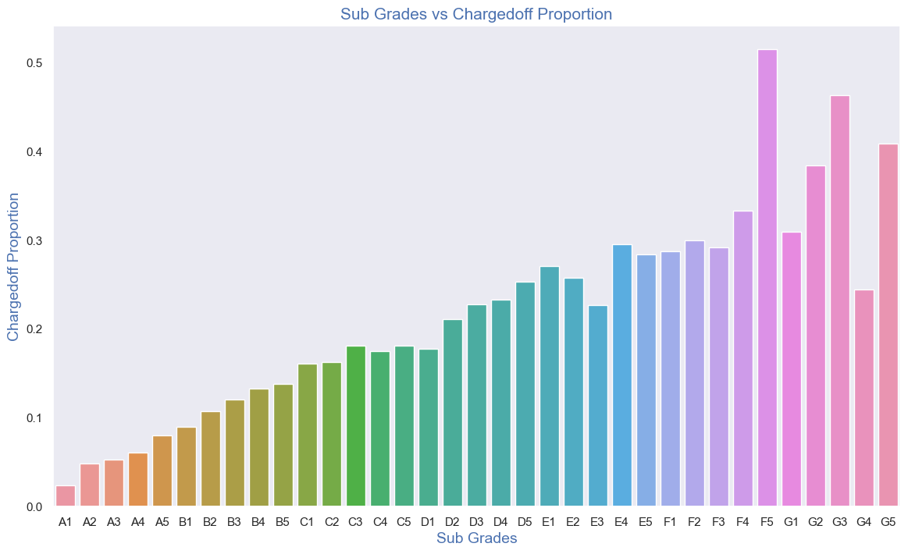
Bivariate Analysis on sub grade against Chargedoff_Proportion
Observations:
sub-Grades of "A" has very less chances of charged off.
sub-Grades of "F" and "G" have very high chances of charged off.
proportion of charged off is increasing with sub grades moving from sub grades of "A" towards sub grades of "G"

Slide 23
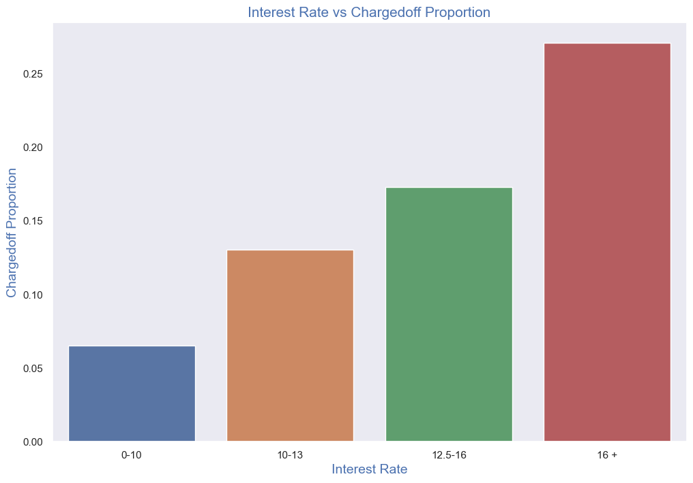
Bivariate Analysis on interest rate against Chargedoff_Proportion
Observations:
interest rate less than 10% has very less chances of charged off. Interest rates are starting from minimum 5 %.
interest rate more than 16% has good chances of charged off as compared to other category interest rates.
Charged off proportion is increasing with higher interest rates.

Slide 24
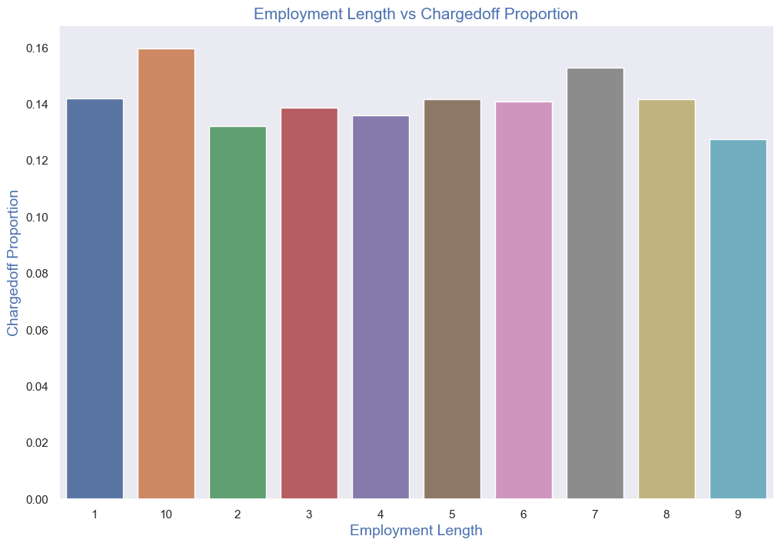
Bivariate Analysis on employment length against Chargedoff_Proportion
Observations:
Those who are not working or have less than 1 year of work experience have high chances of getting charged off.
It makes sense as with less or no experience they don't have source of income to repay loan.
Rest of the applicants have more or less same chances of getting charged off.

Slide 25
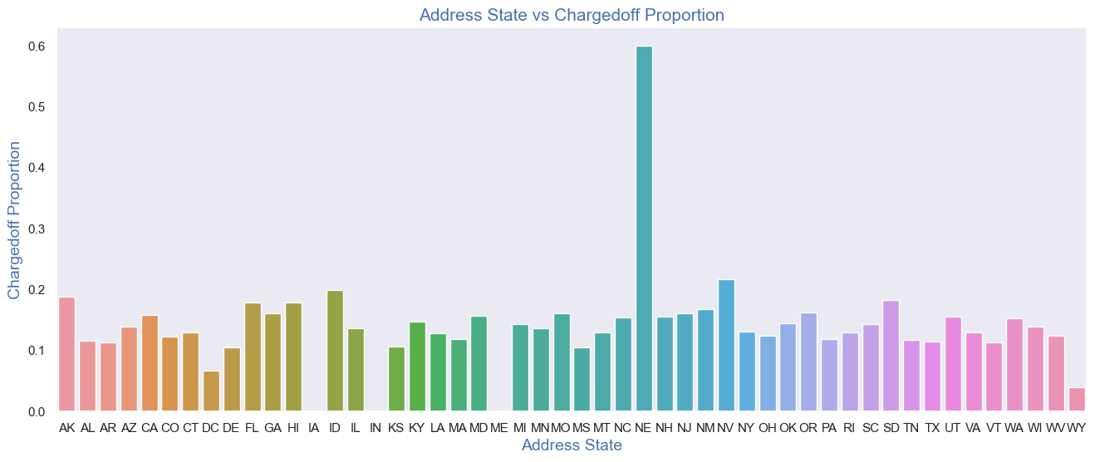
Bivariate Analysis on address_state against Chargedoff_Proportion
Observations:
states NE has very high chances of charged off, but number of applications are too low to make any decisions.
NV,CA and FL states shows good number of charged offs in good number of applications.

Slide 26
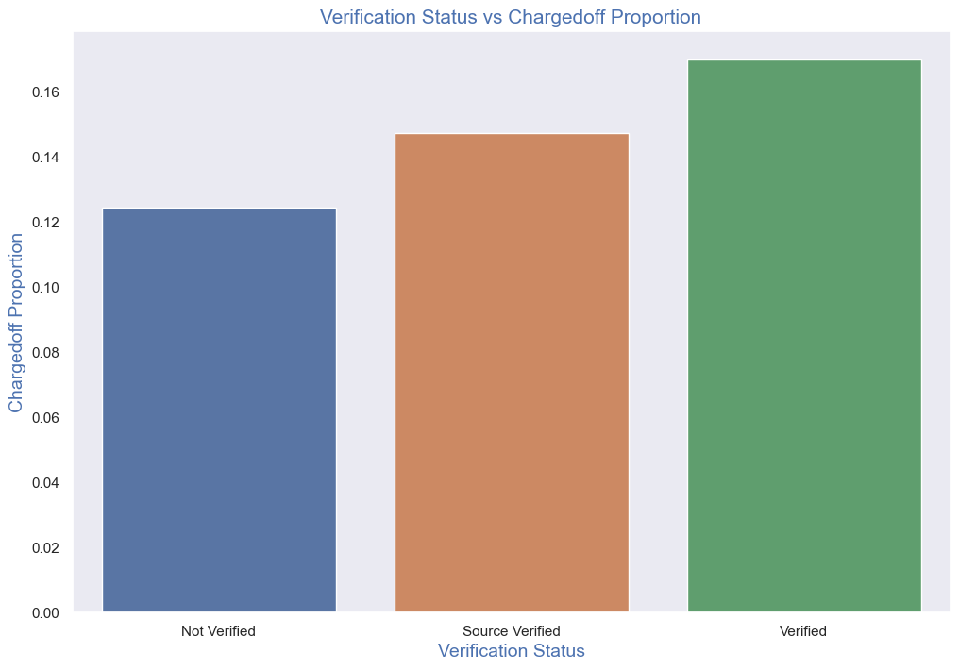
Bivariate Analysis on verification_status against Chargedoff_Proportion
Observations:
There is not much difference in charged off proportion.
This variable doesn't provide any insights for charged off.

Slide 27
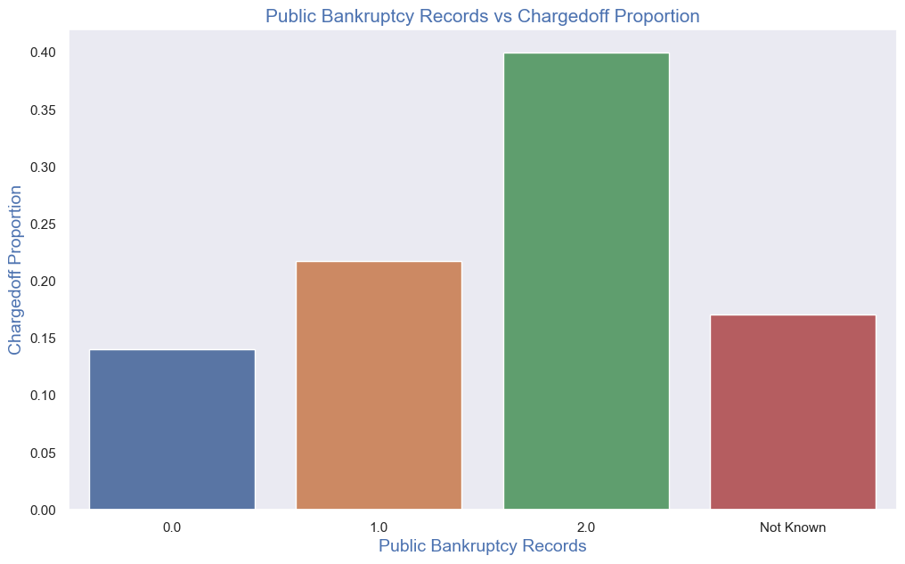
Bivariate Analysis on pub_rec_bankruptcies against Chargedoff_Proportion
Observations:
Those who already have pub_rec_bankruptcies value 1, have charged off proportion higher than who have no pub_rec_bankruptcies.
pub_rec_bankruptcies count 2 has even higher charged off proportion but those numbers are not significant to decide.
Not known is the column for which we don't have any information about borrower.
This also makes sense that who has defaulted before has more chances of defaulting in future as well.

Slide 28
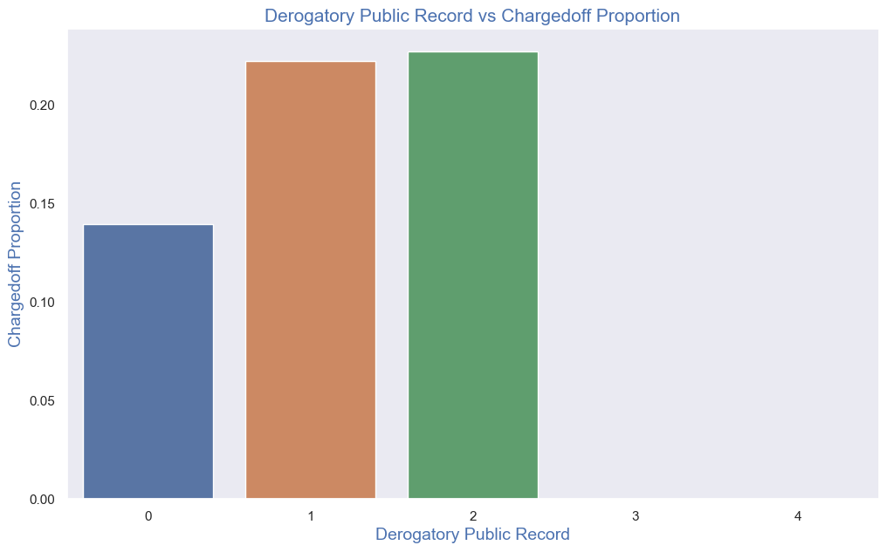
Bivariate Analysis on Derogatory Public Record against Chargedoff_Proportion
Observations:
A derogatory item is an entry that may be considered negative by lenders because it indicates risk and hurts
your ability to qualify for credit or other services. Public records and collections are derogatory items
because they reflect financial obligations that were not paid as agreed.
Those who already have pub_rec value 1 or 2 have charged off chances higher than who have no Derogatory Public Record.
pub_rec count 3-4 has less numbers so cannot reach on any conclusions.

Slide 29
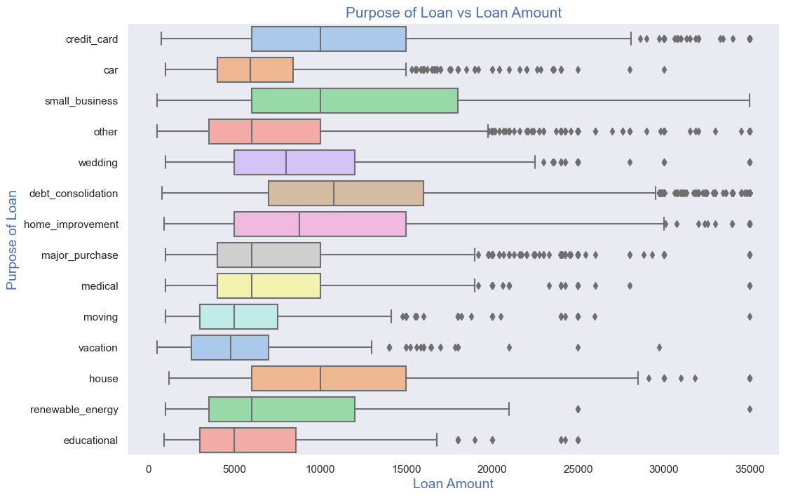
Bivariate Analysis - Purpose of loan vs Loan amount
Observations:
Median,95th percentile,75th percentile of loan amount is highest for loan taken for small business purpose among all purposes.
Debt consolidation is second and Credit card comes 3rd.

Slide 30
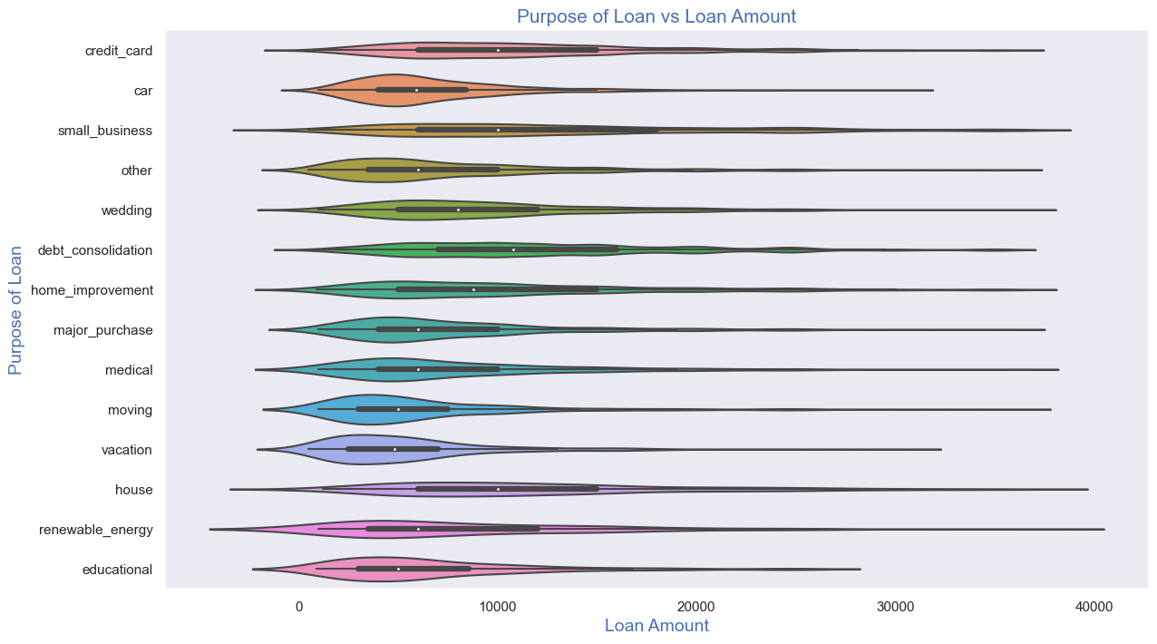
Bivariate Analysis - Puprose of loan vs Loan amount
Observations:
Loan taken for small business purpose, Debt consolidation and Credit card are somewhat evenly distributed
As compared to loan taken for other purposes.

Slide 31
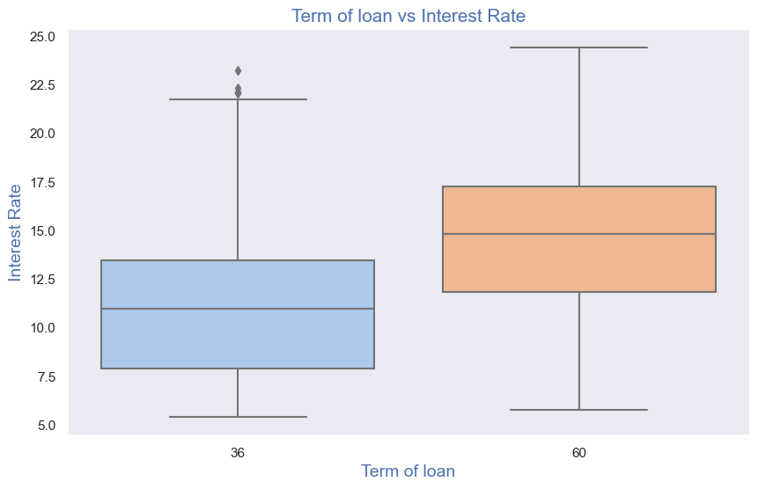
Bivariate Analysis - Term of loan vs Interest Rate
Observations:
It is clear that average interest rate is higher for 60 months loan term.
Most of the loans issued for longer term had higher interest rates for repayment.

Slide 32
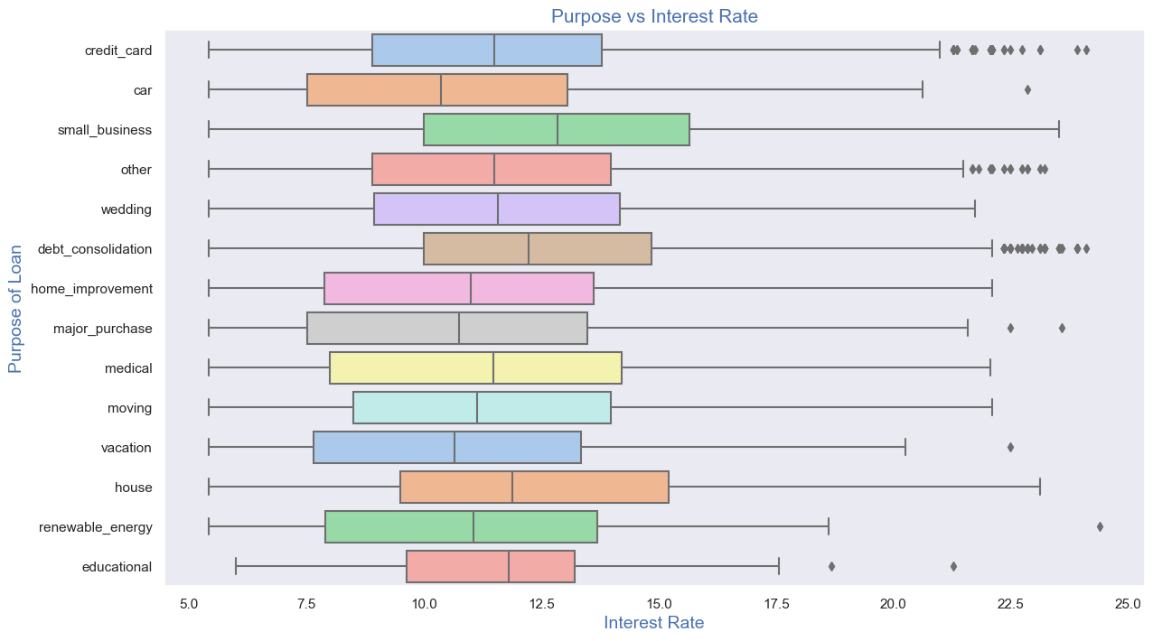
Bivariate Analysis - Purpose vs Interest Rate
Observations:
It is clear that avearge intrest rate is highest for small business purpose.
Loans taken for small business purposes had to repay the loan with more intrest rate as compared to other.
Debt consolidation is 2nd where borrowers had to pay more interest rate.

Slide 33
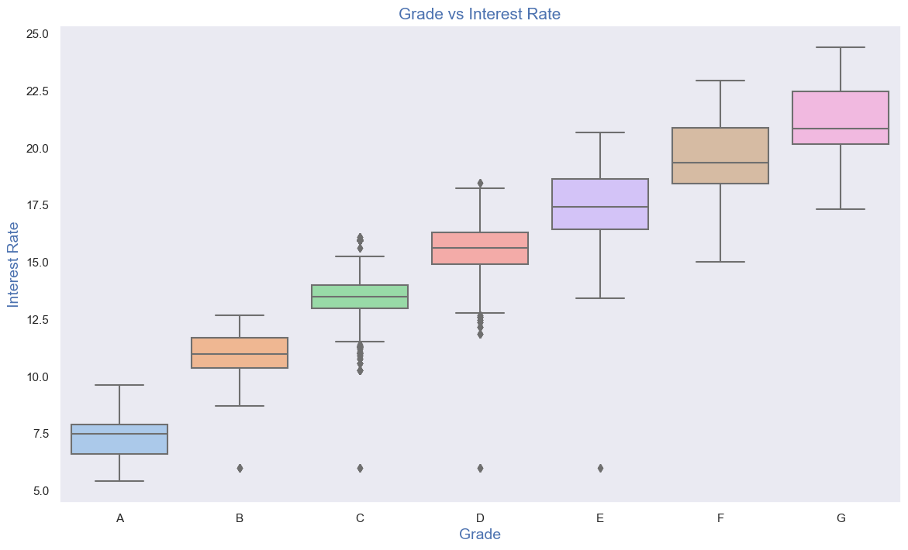
Bivariate Analysis - Grade vs Interest Rate
Observations:
A-grade is a top letter grade for a lender to assign to a borrower.
The higher the borrower's credit grade, the lower the interest rate offered to that borrower on a loan.
It is clear that interest rate is increasing with grades moving from A to F.

Slide 34
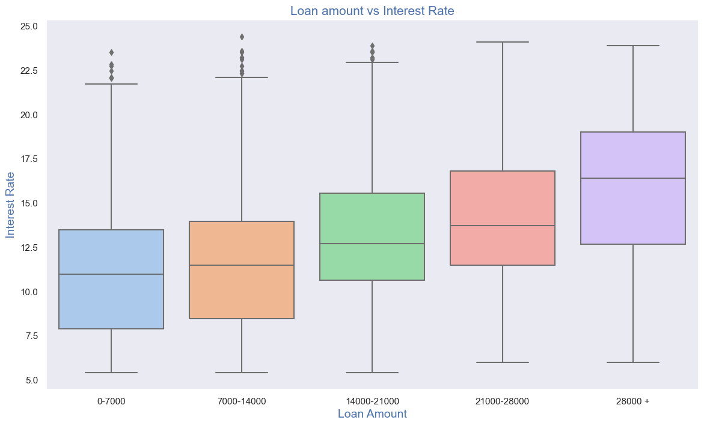
Bivariate Analysis - Loan Amount vs Interest Rate
Observations:
Interest rate is increasing with loan amount increase.
probably when loan amount is more it is taken for longer loan term, we saw earlier that longer the loan term more the interest rate.

Slide 35
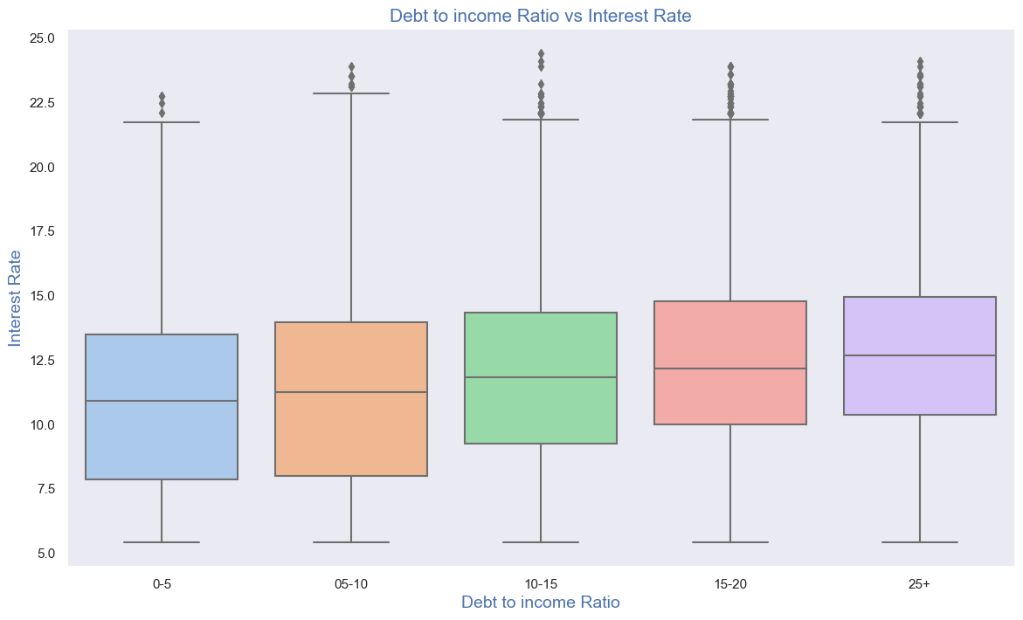
Bivariate Analysis - dti vs Interest Rate
Observations:
If your DTI is low enough you may get a lower interest rate.
Plot shows no significant variation but there is slight increase in interest rate with increase in DTI.

Slide 36
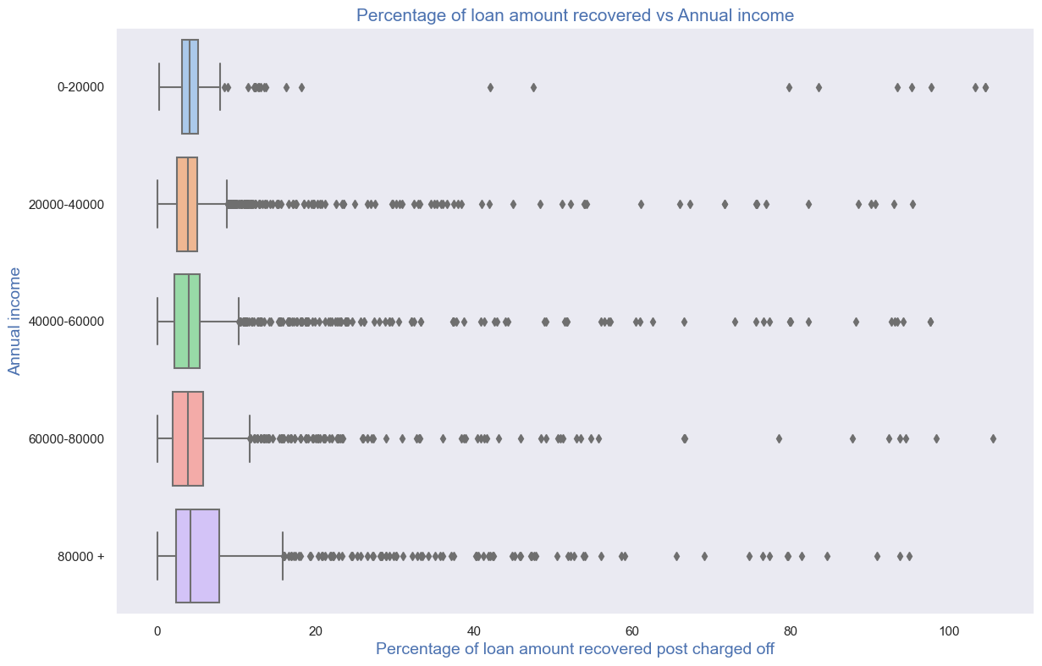
Bivariate Analysis - Recoveries vs Annual income
Observations:
Higher percentage of loan amount is recovered when annual income is high.
Plot shows no significant variation but there is slight increase in recovery percentage with increase in annual income.

Slide 37
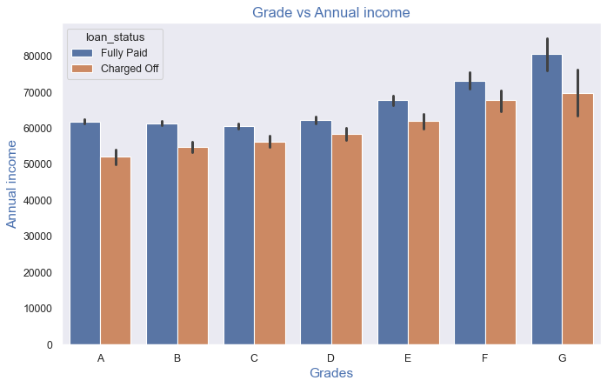
Bivariate analysis variation of annual income across grade for every loan status
Observations:
From this we can conclude that the ones getting 'charged off' have lower annual incomes than the ones
Who 'paid fully' for each grade (i.e., at same interest range)

Slide 38
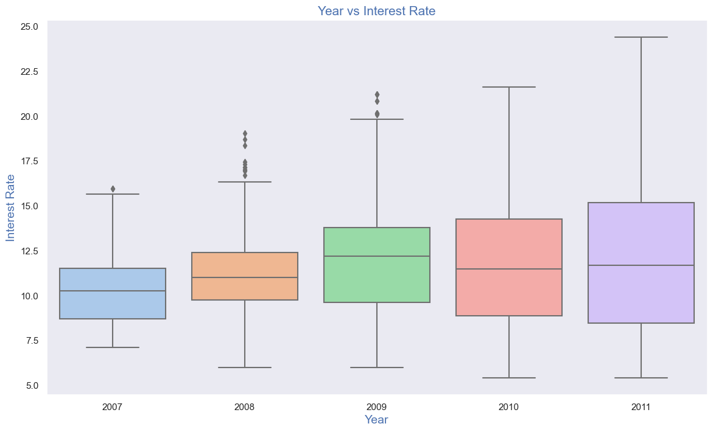
Bivariate Analysis - year vs Interest Rate
Observations:
Plot shows interest rate is increasing slowly with increase in year.

Slide 39
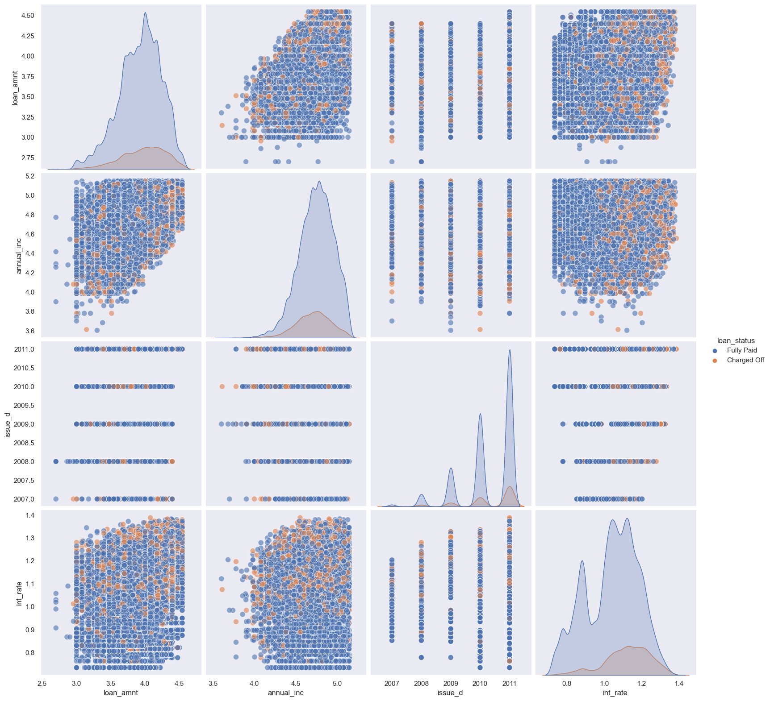
pair plot for multivariate analysis
Observation:
Higher the interest rate higher charged off ratio
Higher the annual income higher the loan amount slightly.
increase in number of charged off with increase in year.
interest rate is increasing with loan amount increase

Slide 40
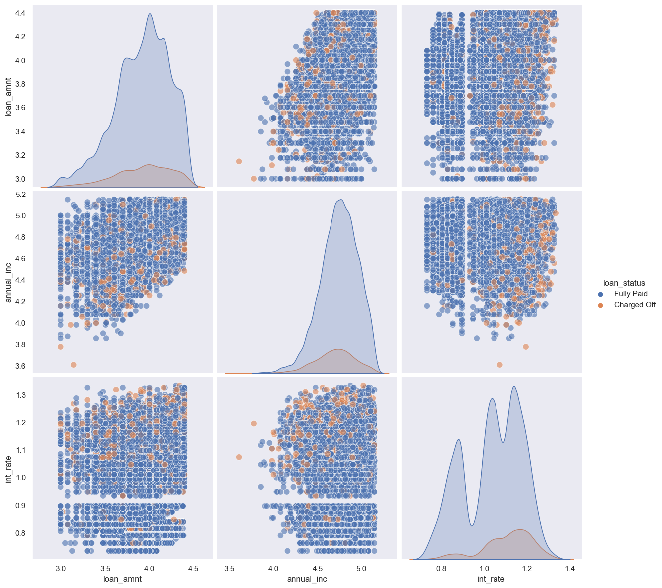
pair plot for multivariate analysis for year 2010
Observation:
Higher the interest rate higher charged off ratio
Higher the annual income higher the loan amount slightly
Interest rate is increasing with loan amount increase this results in high charged off.

